Slide 1
الدكتور المدرس ماهر جبار صالح اختصاص اورام كليه طب البصره antineoplastic drugsعنوان المحاظره :

Slide 2
Introduction
Neoplasm …is an abnormal mass of tissue as a result of Neoplasia ( Neoplasia means new growth in Greek) is the abnormal proliferation of cells)
Classification of Neoplasm
Benign
Potentially malignant
Malignant

Slide 3
Introduction
The normal cell cycle ….as in the picture below
It has many phases to results in tow daughter cells.
Halting any phase can result in failure of the cell division.

Slide 4
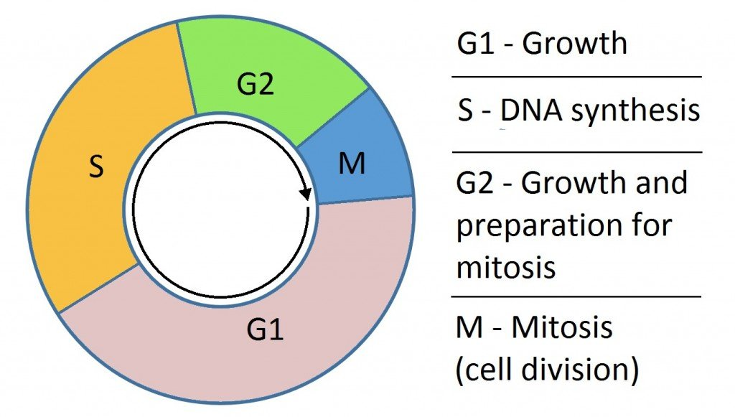

Slide 5
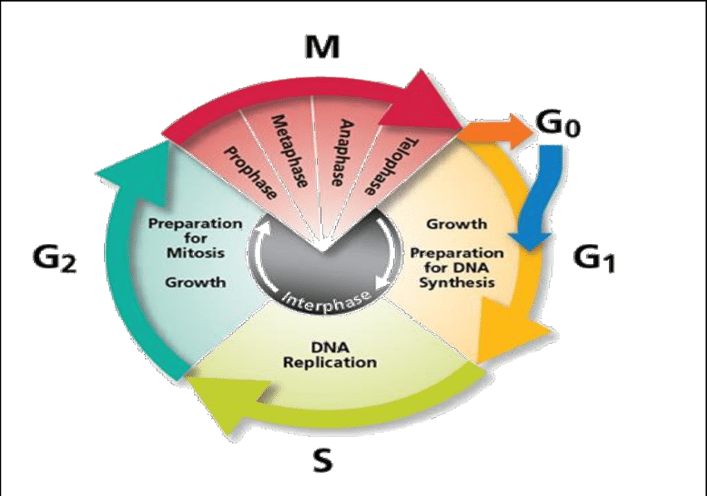

Slide 8
Antineoplastics Don’t kill tumor cells directly; but interrupt development, growth, spread of abnormal cells .
Interfere with cell replication
Example :
Antimetabolites interfere with DNA synthesis.

Slide 9
Classification
1-local therapy : surgery and radiotherapy
2- systemic therapy :
chemotherapy
hormonal therapy
monoclonal antibodies .
Hormonal
radioactive material .
targeted therapy .
immunotherapy .

Slide 10
All of these mentioned methods called antineoplastic agents .
Chemotherapy is one of them , most popular and developing one .
Targeted therapy are more specific .

Slide 11
Surgery :
Is the most first modality for most of the tumours .
Can be curative for some tumors .
The most determinant of successful surgery is the absence of distant metastasis .

Slide 12
Radiotherapy :
Usuallly adjuvant after the primary treatment .
Can be given through external bean RT or localized brachytherapy .
Success depends on difference in the sensitivity between the normal tissue and the malignant tissue .

Slide 13
Chemotherapy :
Historically :
1- Mustasrd gas was used in the world war I,II and the victims of that gas were developing bone marrow suppression and lymphoid hypoplasia . This led to the discovery of using that agent in lymphoma at YALE 1943.
2- 1950 …follic acid was seen to accelerate the malignant cells in leukemia pt , led to the discovery that follic acid antagonist as antineoplastic agents .

Slide 14
3- in the 1960 s…..
Combination chemotherapy had been started .

Slide 15
Types of chemotherapy
1- primary : when it is used to treat highly sensitive tumors without other modalities ( Lymphoma , choriocarcinoma )
2- adjuvant : given after primary treatment of the tumor.( breast , colon , lung )
3- neoadjuvant : given before the primary treatment to shrink the tumor and facilitate surgery .( breast cancer , osteosarcoma )
4- concurrent chemoradio : at the same time of radiotherapy as radiosensetizer (head and neck ).

Slide 17
Chemotherapy principle
1- We have to balance between the therapeutic dose needed to kill the cancer cells(MTD :maximal tolerated dose ) and the
side effects of such doses .
: 2- combination of chemotherapy
Maximize the cell kill through acting on different stages on the cell cycles and also decreasing the drug resistance .

Slide 18
Important concepts
1- Phase specific chemotherapy : act on specific phase in the cell cycle and higher dose of chemotherapy will not result in more cell
killing…
S phase ( antimetabolite , topoisomerase I )
M phase ( vinca alkaloid , taxane )
G2 ( bleomycin)
2- phase non specific : has linear dose/response effect , larger dose means more cell killing .
Example : alkalating agents , antibiotics .

Slide 19
Routes of administrations
1- IV…common …doxorubicin
2-oral ……nevelbine
3-intrathecal ………MTX
4-intraperitoneal ….cisplatin
5-intraarterial …..cisplatin
intrapleural ….bleomycin 6-
7- subcutaneous……..GNRH
8- intravasical …..mitomicin

Slide 21
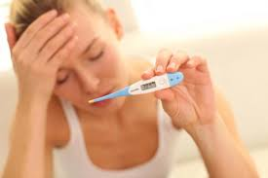
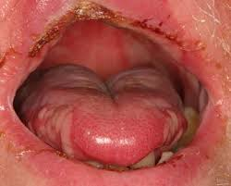
Fever mucositis

Slide 22
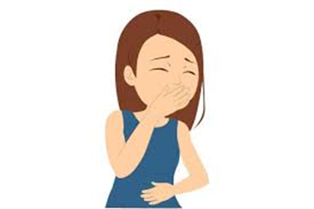
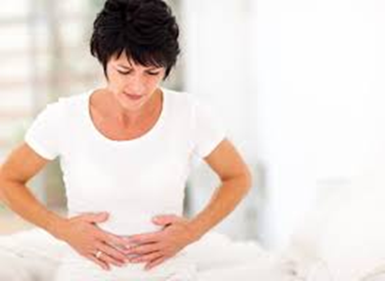

Slide 23
General side effects :
Nausea / vomitting
BM suppression .
Alopecia
Infertility
Diarrhea
Mucositis .

Slide 24
Specific side effects :
Lung toxicity ……..bleomycin
Cardiotoxicity …….doxorubicin
Renal impairment ……cisplatin
Neuropathy ……….vincristin
Bone marrow suppression ……carboplatin
Liver damage ………..taxan group
Hemorrhagic cystitis ………….cyclophosphomide

Slide 25
Response criteria :
1- complete response : complete disappearance of the tumor .
2- partial response : more than 50 % decrease in size .
3- stable disease : response less than 50% or progression but less than 20 %
4- progressive disease : progression more than 20 % .

Slide 26
Major classification
1- alkalating agents : by adding alkyl gorup to interfere with the DNA synthesis .
Melphalan……….MM
Busulphan …CML
Cyclophosphamide…….breast
Iphosphamide………..bone malignancy
Chlorambucil….CLL

Slide 27
2- antimetabolites
Affect the S phase of the cell cycle .
1- MTX ……choriocarcinoma
2- pemitrexate…..mesothelioma
3- capecitibin….pancrease cancer .
4- 5 FU….ca colon
6- 6MP………….. in ALL
7- CYTARABIN………….in ALL

Slide 28
3- antibiotics
Derived from microorganism , ultimatly affect the DNA synthesis.
Doxorubicin ….breast
Actinomycin D …Ewing sarcoma
Bleomycin …ca testis
Mytomycin c……bladder ca
Dounorubicin…ALL

Slide 29
4- mitotic spindle inhibitors
Affect the M phase of the cell cycle .
Cell specific chemotherapy .
1- Taxan group: paclitaxil , docetaxil …in breast ca .
2- vinca alkaloid …
Vincristin……….in NHL
vindesin ,
vinorelbin ,
vinblastin

Slide 30
5- topoisomerase inhibitors
1 - Etopoide ….in testis cancer
2- irinotecan……ca colon
3- topotecan …..ca ovary

Slide 31
6- tyrosine kinase inhibitors (targeted therapy )
…nib
Certain target in /on the cell
More specific action than chemotherapy
Imatinib …..on bcr-abl gen….. CML
Sunitinib ….on VEGFR ,FLT3 ….renal carcinoma .
Erlotinib …..on EGFR …..lung cancer

Slide 32
7-Monoclonal antibodies.
Attach to a ligand that is specific to that antibody , will hinder the normal action needed for cell growth and division .
Bevasuzumab …..on VEGFR…….. in ca colon
Cetuximab ………. On EGFR ……..in ca colon
Trastuzumab …on HER2neu … in breast cancer

Slide 34
8- hormonal therapy
Tamoxifen ….block the estrogen in breast ca.
Androgens….antagonise the estrogen in breast cancer .
GNRH analoques …in prostate cancer
Progetrone …..in uterus cancer . .

Slide 35
The immunotherapy
PDL-1 …. Programmed cell death protein or its receptor when activated will cause death of the cell.
Tumor cells are clever enough to secrete substances or proteins that activate the PDL1 found on the lymphocyte causing death of that lymphocyte.
So if we block these substances or the PDL-1 receptors ……will maintain life of these lymphocytes and more controlling of the tumour

Slide 36
Thanks

